Slide 1
www.shared-interest.com
Notes:
The Sustainable Development Goals (SDGs), otherwise known as the Global Goals, are a universal call to action to end poverty, protect the planet and ensure that all people enjoy peace and prosperity.
These 17 Goals build on the successes of the Millennium Development Goals, while including new areas such as climate change, economic inequality, innovation, sustainable consumption, peace and justice, among other priorities. The goals are interconnected – often the key to success on one will involve tackling issues more commonly associated with another.
The SDGs came into effect in January 2016, and they will continue to guide UNDP policy and funding until 2030.
What do they look like to you? – achievable? Any idea what you can do as an individual?

Slide 2
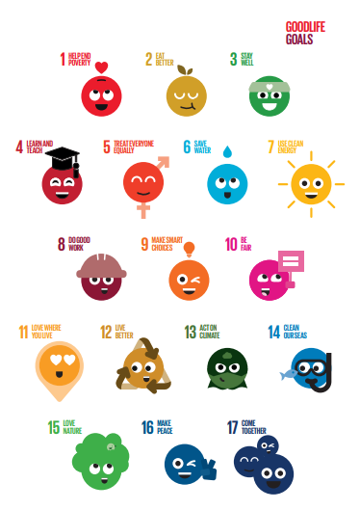
Enter…
www.shared-interest.com
Notes:
The Good Life Goals
People power matters as much as powerful people. With our voice, our actions and how we treat each other and the world around us.
But we need to know what to do: the simple, collective and impactful actions people can take everywhere around the world.
The Good Life Goals will give everyone a role in making tomorrow better than today.
85 individual actions - 5 asks for each of the 17 SDGs

Slide 3
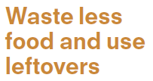
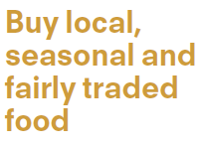
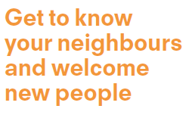
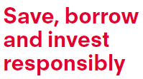
Good Life Goals Bingo
www.shared-interest.com
Notes:
Everybody raise your hand please
keep your hand raised if you have done or do this – anyone like to share what they have done for this?
repeat, repeat until last hand(s) taken down

Slide 4
Shared Interest and the SDGs
www.shared-interest.com
Notes:
Which of the SDGs we’ve identified that we feel we can contribute best to
Give examples of how what we do, with our members, is achieving this

Slide 5
How can we help make tomorrow better than today?
www.shared-interest.com

